Slide 1
Research article writing
Mahesh S K
Assistant Professor
Dept. of Physics
N.S.S. College,Pandalam
Pathanamthitta, Kerala

Slide 2
OUTLINE OF PRESENTATION
Why to publish and what are the difficulties?
Which type of article I choose?
Which journal?
Objectives
Writing a manuscript
Publication in journals
Conclusions

Slide 3
Why publish and what are the difficulties?
Why to publish?
It leaves a record of research and receive due recognition for ideas and results.
It helps in receiving expert feedback on results and discussion.

Slide 4
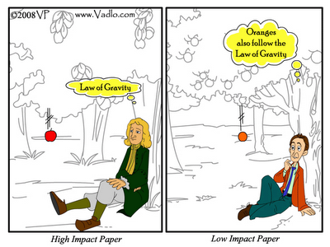
Why publish and what are the difficulties?
Difficulties
Lesser novelty and scientific interest.
Experiments do not work positive

Slide 5
Type of articles
Communications: brief reports of data from original research that the authors believe will be interesting to many researcher.
Original Research: publish full reports of data from research.
Review Articles: comprehensive summary of research on a certain topic, and a perspective on the state of the field.
Methods: present a new experimental method, test or procedure.

Slide 6
Journal types
Publishes General science: Eg. Science, Nature etc.
Publishes broad subject: Eg. Chemistry an An Asian Journal, Journal of basic and applied zoology etc.
Publishes specific area of a branch with specific scope: Eg. Journal of catalysis, Corrosion science, Aquatic botony etc.
Publishes only communications: Eg. Chemcomm, Physics letters A etc.
Publishes only reviews: Eg. Chemical review, Computer secience review etc.

Slide 7
Objectives
To give an insight to the beginners for effective writing of an article and steps for publishing a research output.

Slide 8
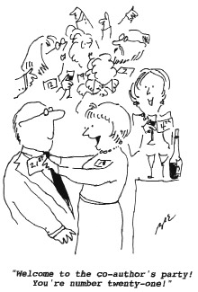
Art of scientific writing
Most articles have a structure of IMRaD and its variations
Title: Title of article should summarize the main theme of the research and reflects its contribution to theory.
Author name and affiliation: Author names and affiliation to be given.
Multiple affiliations to be specified.
Corresponding author to be provided.
Abstract: Known as summary
100-150 words.
Focus on scope, key problem, method, key findings and applications
Key words: Regarding the research.
Important for searching online.
Notes:
In scientific writing, IMRaD (/ˈɪmræd/) (Introduction, Methods, Results, and Discussion) refers to a common organization structure. IMRAD is the most prominent norm for the structure of a scientific journal article of the original research type.

Slide 9
Introduction:
Importance of the problem
Literature review and status of problem, limitations
Need of present study, how it overcome present gap
Objectives
Additional statement that justify study
Methods: information about how the work has done
Helps one to reproduce results
Transparency in method
Novel method should be given in detail
Results: Evidence to support objectives
Represent by figure, table or text
Table helps in showing raw or processed data
Figure helps in showing overall trend and comparison
Figures must be self explanatory
Do not include too much data in figure

Slide 10
Discussion: explain the results and correlate to problems discussed in introduction
Refer to the main purpose of study
Explanation of findings
Limitation of study
Recommendation on future aspects
Conclusions: summary of the paper
Do not repeat abstract
Show how the work advances from the present knowledge
Provide scientific justification of work
Acknowledgments:
Feel free to acknowledge
Funding agency
Outsourced work
Valuable inputs

Slide 11
References: all the works that has been cited in manuscript
Each journal has its own style
Two types
Citation-sequence: reference are listed in sequence in which they first appear in text.
Eg: A work by Lazer is number 32 in text will have reference at 32
Name-year: text reference consist of surname of the first author followed by year of publication.
References:
Give complete author list: no et al in reference
Some common styles of references:
Author name, Journal name, volume, year, page no.
Author name, title, Journal name, volume, year, page no.
Author name, year, journal name, volume, page no.
Author name, title of the book, year, Publisher, page no.
Abbreviate journal name as per standard: eg: Journal of Catalysis as J. Catal. and not Jour. Cat., J. Cataly. Etc.

Slide 12
Key parts a reader may be interested
Many journals provide
Graphical abstract: many journals ask for a graphical abstract
Figure with 4-5 bullet points
Should specify the theme and key findings of the work
Highlights: 3-4 bullet points describing the work
Micro presentation: presentation in 2 minutes
PowerPoint with audio describing the work
http://www.sciencedirect.com/science/article/pii/S0926860X14000040

Slide 13
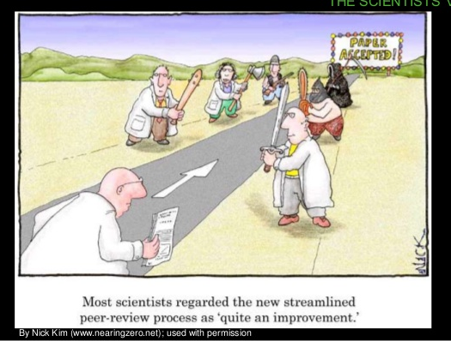
Publishing an article
Choose a journal
Prepare manuscript as per guidelines : Use if a template is available or LaTex, MS Word
Get grammatically corrected
check for plagiarism - Turnitin
Cover letter explaining the importance of the work and conflict of interest
List of reviewers
Revision of manuscipt
Thoroughly go through the reviewer comments
Write a rebuttal
Cover letter for revision
Acceptance

Slide 14
CONCLUSIONS
A well organized writing increases probability of acceptance of manuscript
Always stick on to the guidelines of journals
Answer reviewers comments
Bibliography
Writing Scientific Research Articles: Strategy and Steps, M. Cargill, P. O’Connor, 2009, Wiley-Blackwell.
R. J. Hoogenboom, R. . Manske, Int. J. Sports Phys. Therapy, 7 (2012), 512-517.
https://www.elsevier.com/connect/11-steps-to-structuring-a-science-paper-editors-will-take-seriously

Slide 15
Thank you
& Keep publishing

